Slide 1
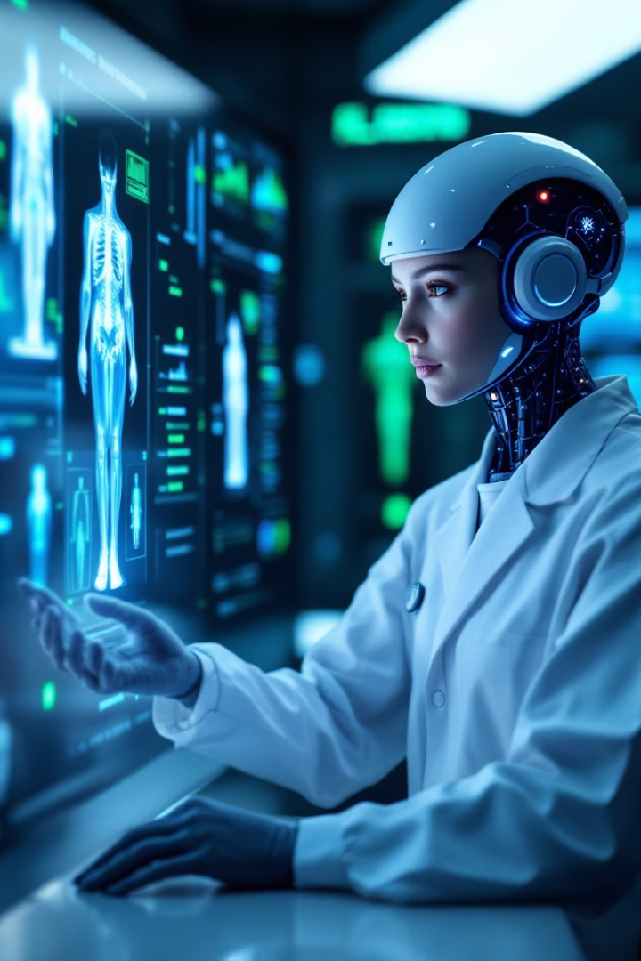

AI-Powered Medical Report Analysis Tool
Simplifying medical data through OCR, NLP, and Computer Vision
By Venkata Sai Krishna Aditya Vatturi
by Venkata Sai Krishna Aditya Vatturi

Slide 2
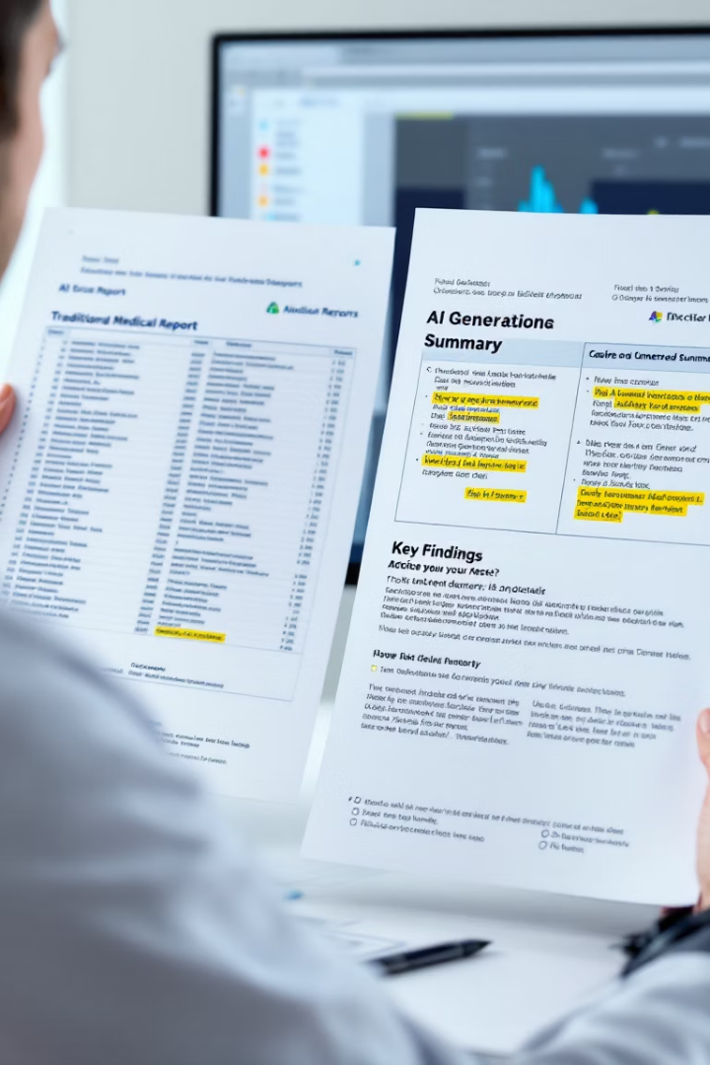



What is this project about?
Medical Report Analysis
AI-powered tool to analyze complex medical documentation
Multiple AI Technologies
Combining OCR, NLP, and Computer Vision
Dual Beneficiaries
Structured insights for both doctors and patients

Slide 3

Why this matters
Complex Reports
Medical terminology creates barriers to understanding
Patient Confusion
Terminology often incomprehensible to non-medical people
Doctor Time Drain
Physicians spend hours analyzing reports manually
Need for Automation
Healthcare requires intelligent assistants to improve efficiency

Slide 4





What the tool aims to achieve
Comprehensive Analysis
Process both text reports and medical images
Text Extraction
NLP to summarize key medical findings
Abnormality Detection
Identify concerning areas in medical imagery
Audience-Specific Output
Different summaries for patients vs clinicians

Slide 5








How it works
OCR
NLP
Extract text from scanned medical reports
Summarize notes and highlight important results
Visualization
Computer Vision
Present structured data with heatmaps
Analyze medical images using CheXNet

Slide 6
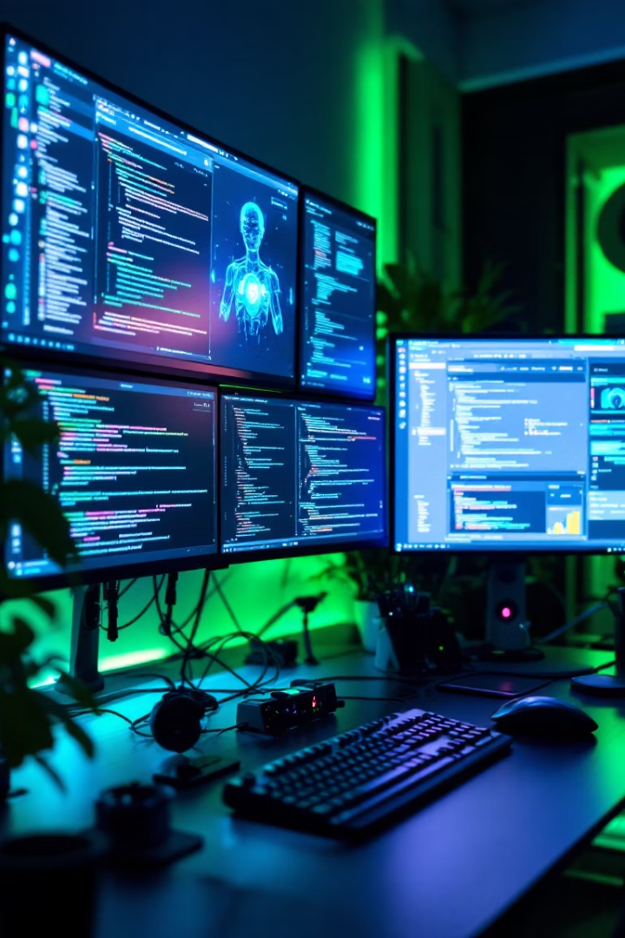
The tech stack behind it
Languages
Python, JavaScript
Frameworks
FastAPI, ReactJS
Libraries
TensorFlow, PyTorch, OpenCV, spaCy
Models
Tesseract OCR, BioBERT, CheXNet
Storage
PostgreSQL / Firebase

Slide 7
End-to-end workflow
User Interface
ReactJS upload interface for medical documents
Backend Processing
FastAPI handles requests and AI model orchestration
AI Analysis
NLP and vision models extract medical insights
Data Structuring
Converting raw findings into organized information
Visualization
Creating downloadable reports with annotations

Slide 8





Impact & Benefits
Efficiency Boost
Doctors review reports in half the time
Doctor Relief
Reduced cognitive load for medical professionals
Patient Understanding
Medical information in plain language
Enhanced Diagnostics
AI helps catch issues humans might miss

Slide 9



Case Study – John Smith
Patient Uploads
John uploads X-ray and lab results
AI Analysis
System identifies pneumonia indicators
Report Generation
Creates visual heatmap and dual-purpose summaries

Slide 10
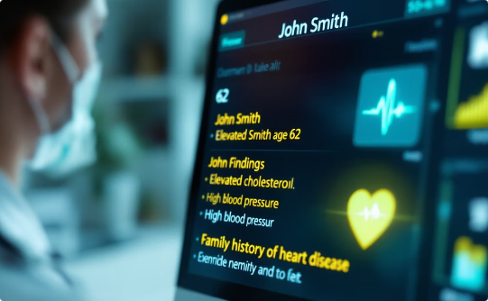
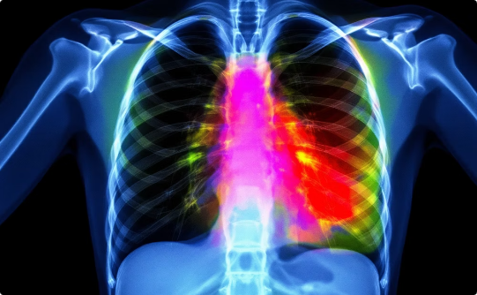
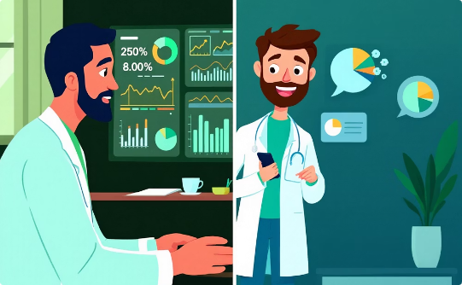
What the tool delivers
Summarized Findings
Annotated Imagery
Dual Summaries
Key results extracted from complex reports
Visual identification of concerning areas
Technical for doctors, simplified for patients

